Slide 1
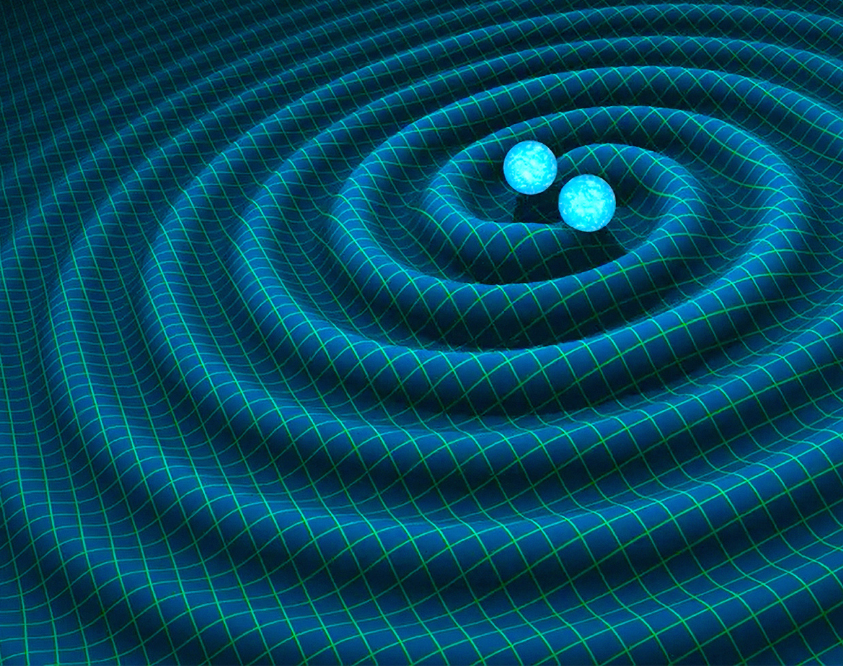



Using Convolutional Autoencoders for Signal Detection of Extreme Mass Ratio Inspirals Detected by the LISA Mission
By Amin Boumerdassi
Supervisor: Dr Matt Edwards

Slide 2
Challenges in Analysing EMRIs

Slide 3
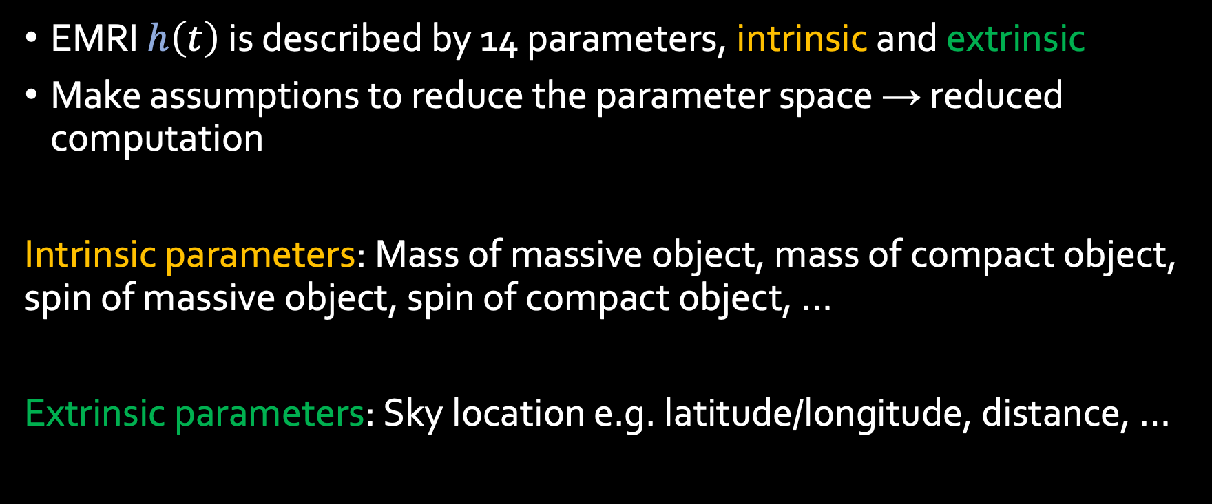
Modelling EMRIs
EMRI $h\left(t\right)$ is described by 14 parameters, intrinsic and extrinsic
Make assumptions to reduce the parameter space → reduced computation
Intrinsic parameters: Mass of massive object, mass of compact object, spin of massive object, spin of compact object, …
Extrinsic parameters: Sky location e.g. latitude/longitude, distance, …

Slide 4
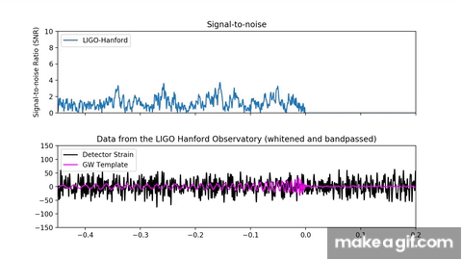
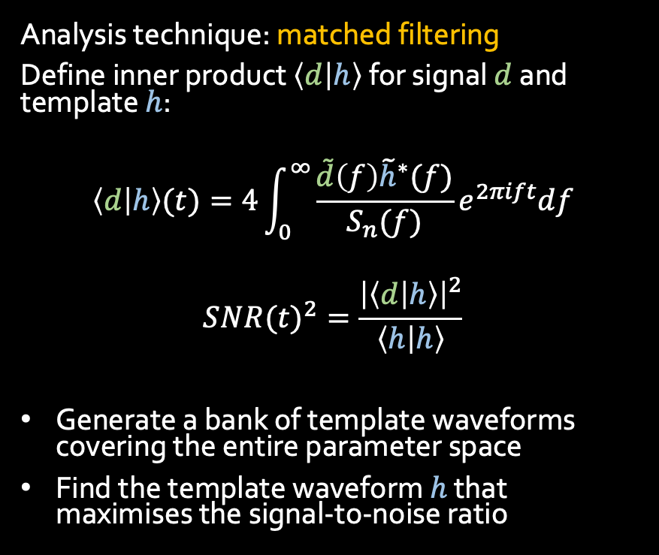
Conventional Signal Detection
Analysis technique: matched filtering
Define inner product $\left\langle d | h\right\rangle$ for signal $d$ and template $h$:
$$\left\langle d | h\right\rangle (t)=4\int_{0}^{∞}{\frac{\tilde{d}\left(f\right){\tilde{h}}^{∗}(f)}{S_{n}(f)}e^{2πift}df}$$
$$SN{R(t)}^{2}=\frac{{\left|\left\langle d | h\right\rangle \right|}^{2}}{\left\langle h | h\right\rangle }$$
Generate a bank of template waveforms covering the entire parameter space
Find the template waveform $h$ that maximises the signal-to-noise ratio

Slide 5

Conventional Signal Detection
Matched filtering is not suited to EMRIs because:
High dimensional parameter space
${10}^{40}$ templates needed
Large template file size
EMRI waveform models are very computationally time-consuming
Can ML come to the rescue?

Slide 6
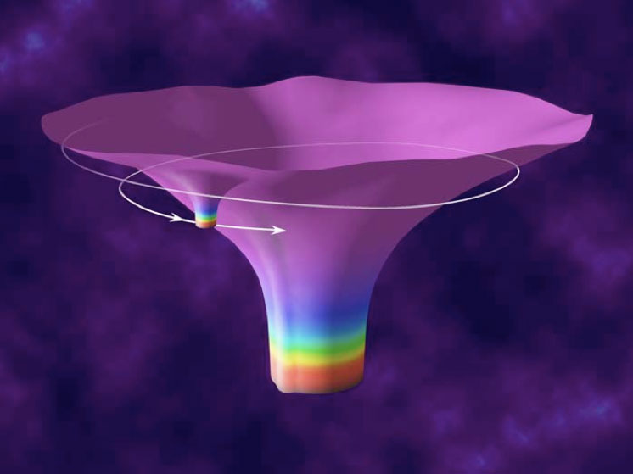
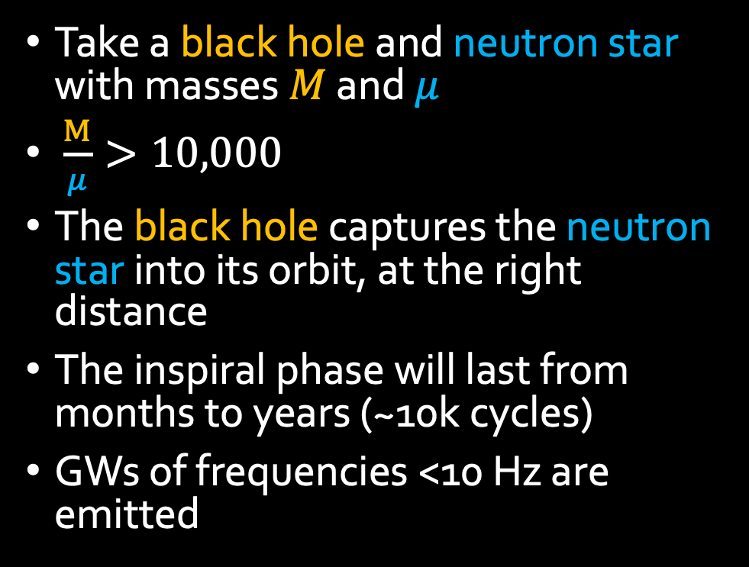
Extreme mass-ratio inspirals (EMRI)
Take a black hole and neutron star with masses $M$ and $μ$
$\frac{M}{μ}>10,000$
The black hole captures the neutron star into its orbit, at the right distance
The inspiral phase will last from months to years (~10k cycles)
GWs of frequencies <10 Hz are emitted

Slide 7
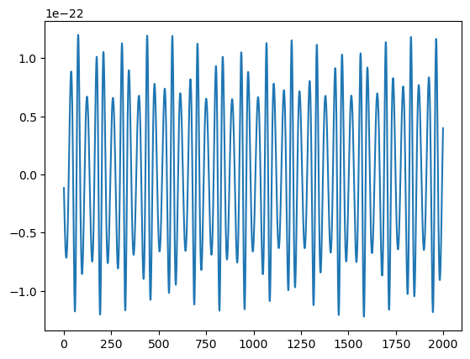

Why ML might be a good fit for EMRI data analysis
Trained ML models are:
computationally inexpensive
process large amounts of data in short time
“generalisable” in performance
Relevant application: rapid generation of EMRI waveforms
Generates years-long signals in <1s

Slide 8
So what am I doing?
Develop ML-based procedures for data analysis of LISA EMRIs. In particular:
Train a convolutional autoencoder to detect EMRI signals

Slide 9
Machine Learning Fundamentals

Slide 10

What is ML?
Definition: Developing models and algorithms to perform a task without explicit instruction.
Applications:
Image colorisation
Facial recognition
Sentiment analysis
Self-driving cars
Translations
Spam filters
Online shopping security
And many more!

Slide 11
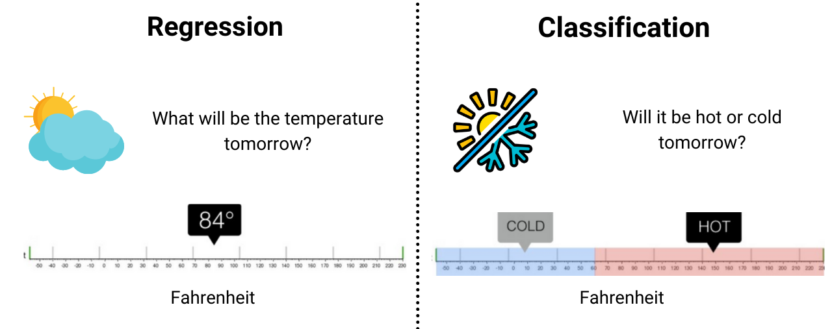
How to frame ML problems
Note: many problems can framed either through regression or classification

Slide 12
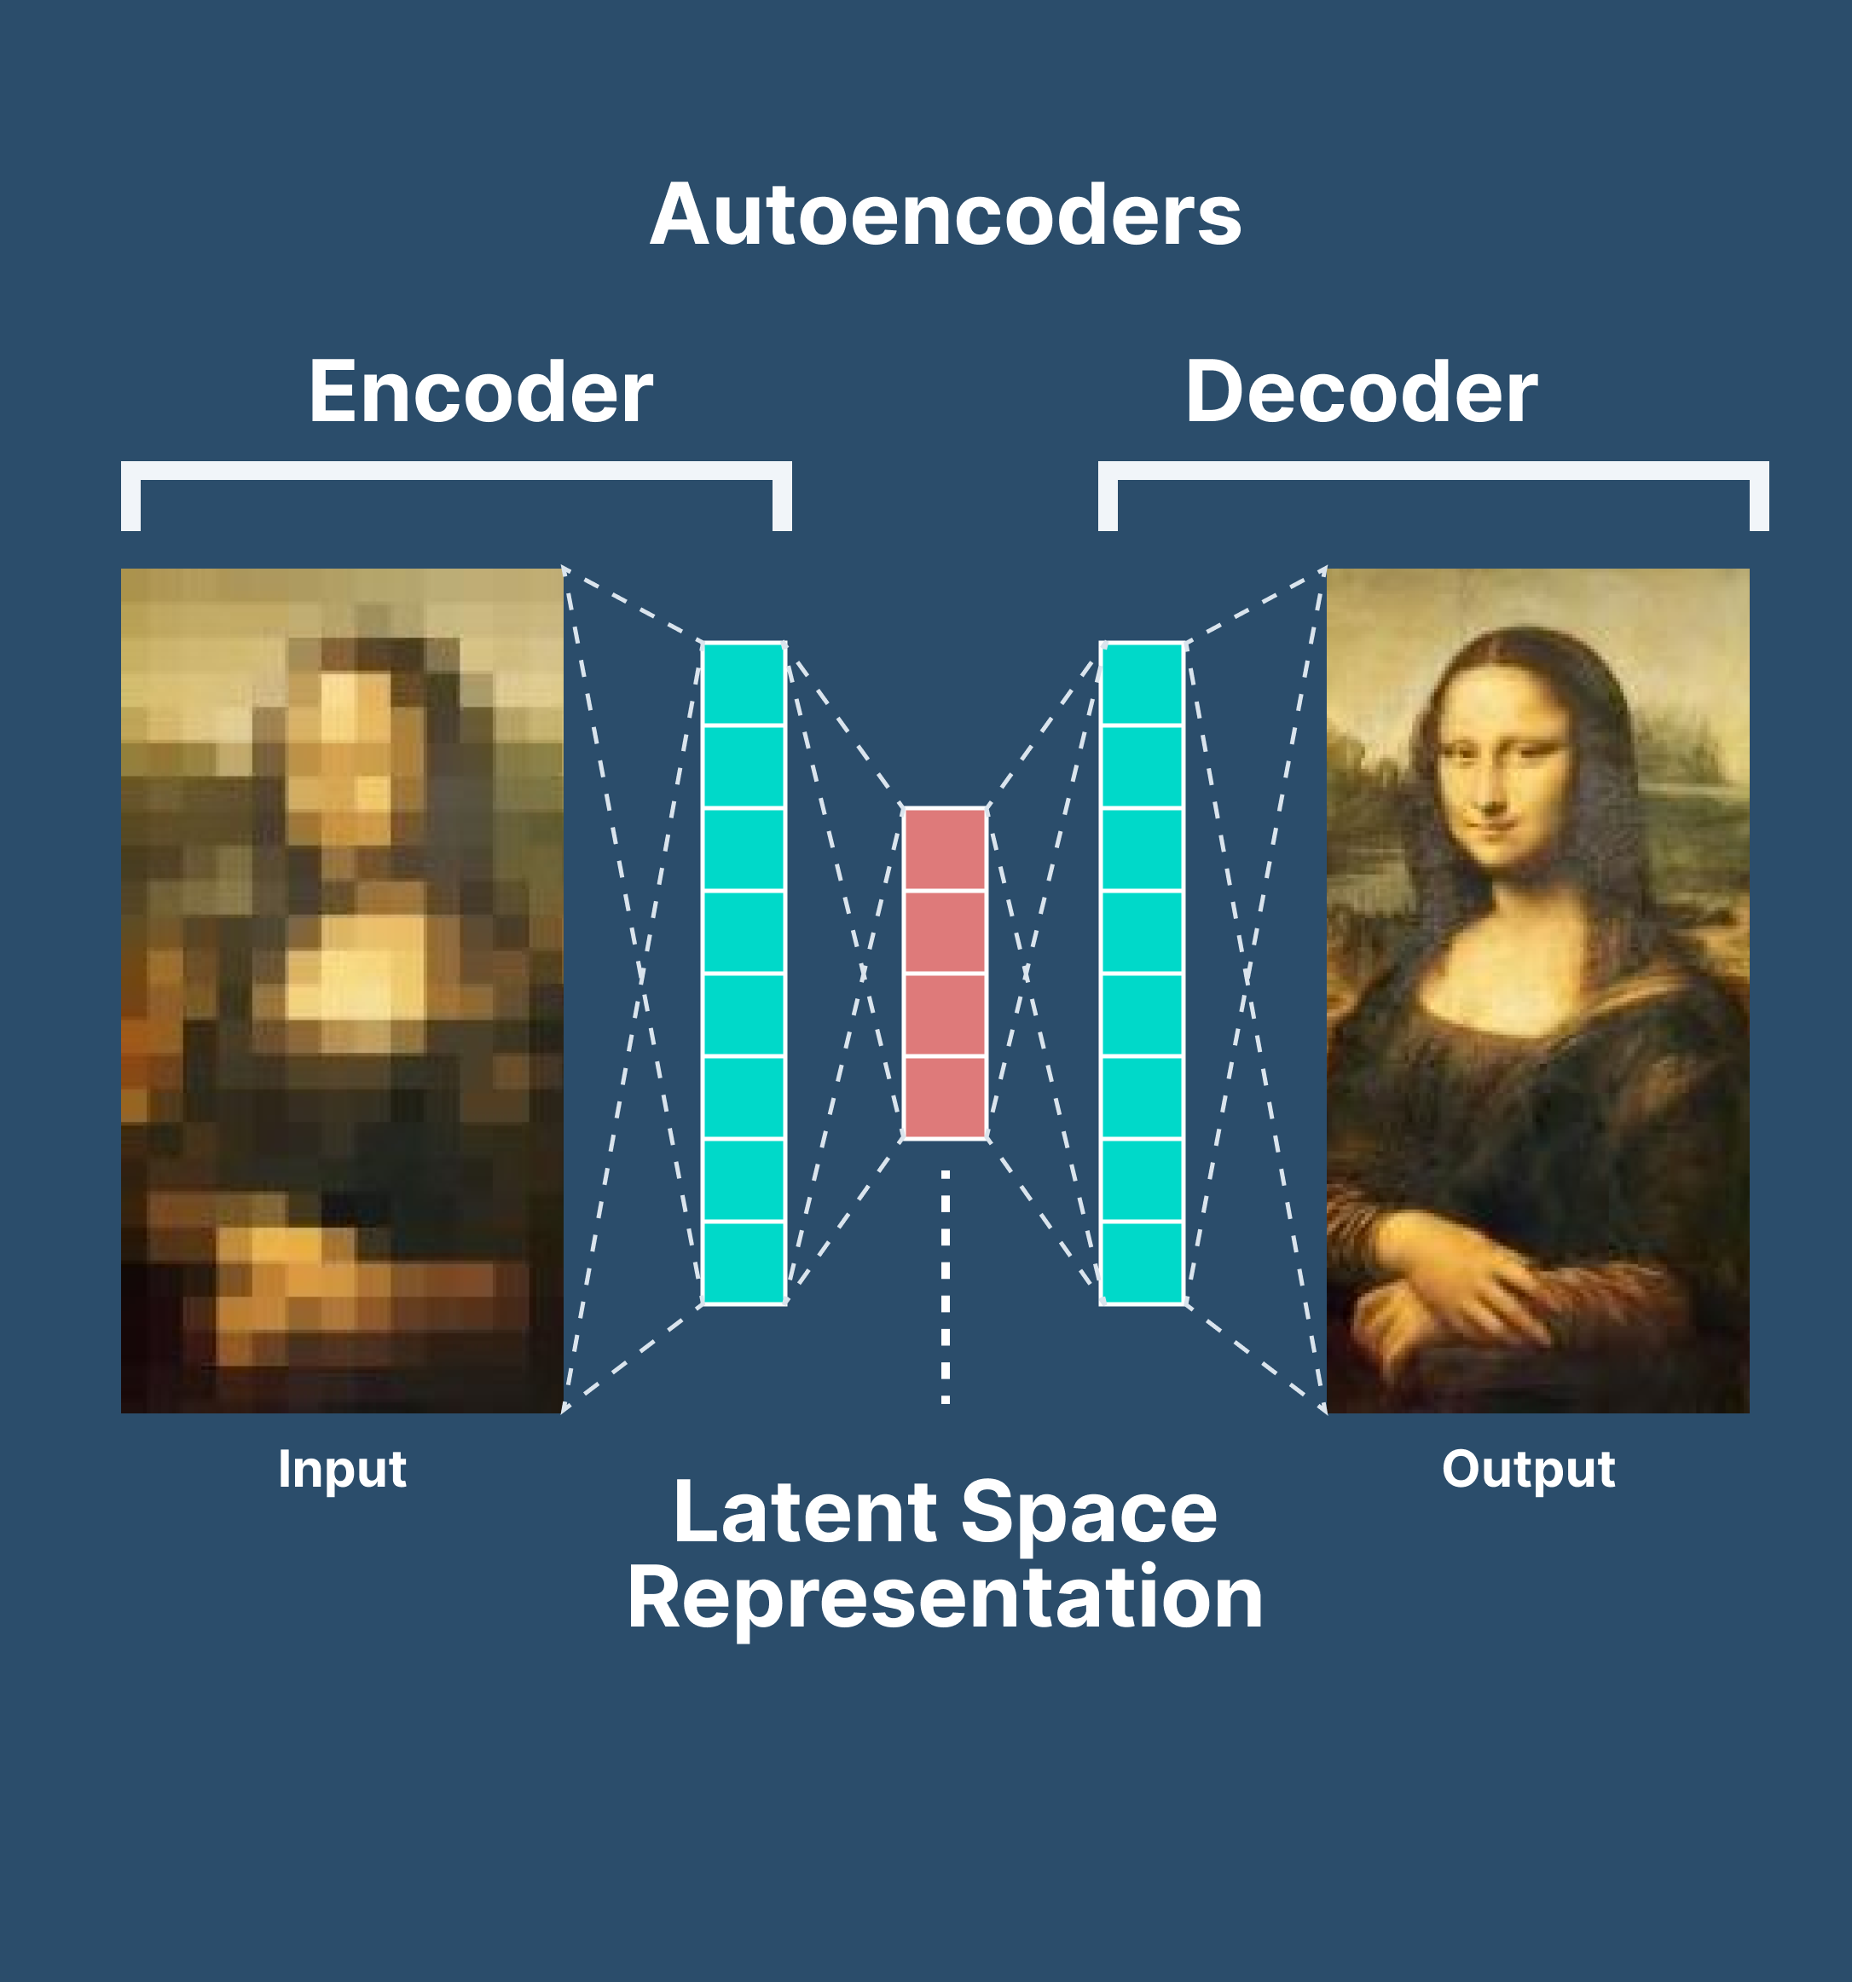
What ML Model I’m using
Autoencoders!
Common applications:
Anomaly detection
Dimensionality reduction

Slide 13
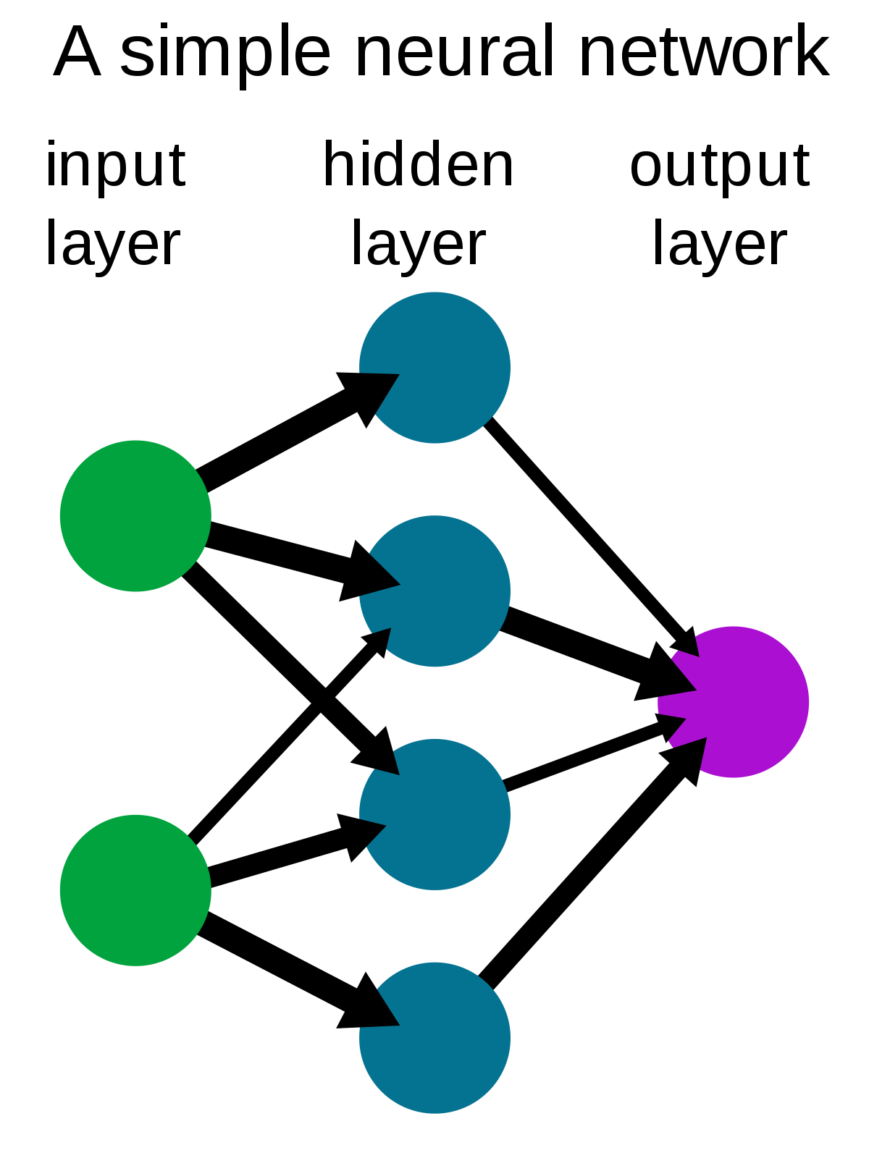
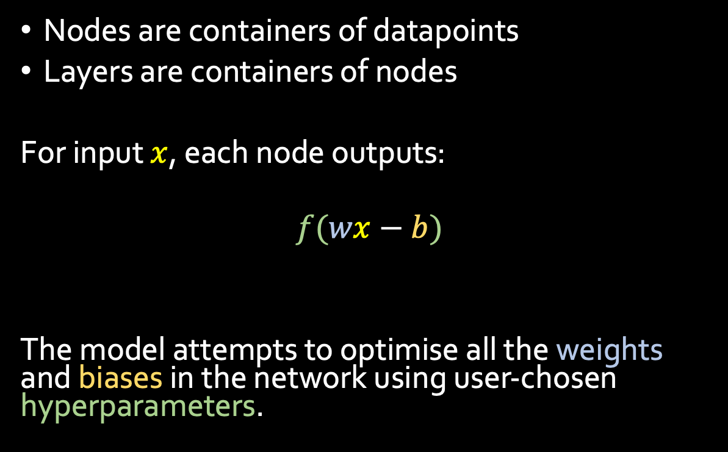
ML model components
Nodes are containers of datapoints
Layers are containers of nodes
For input $x$, each node outputs:
$$f(wx−b)$$
The model attempts to optimise all the weights and biases in the network using user-chosen hyperparameters.
Node weight
Activation function
Node bias

Slide 14
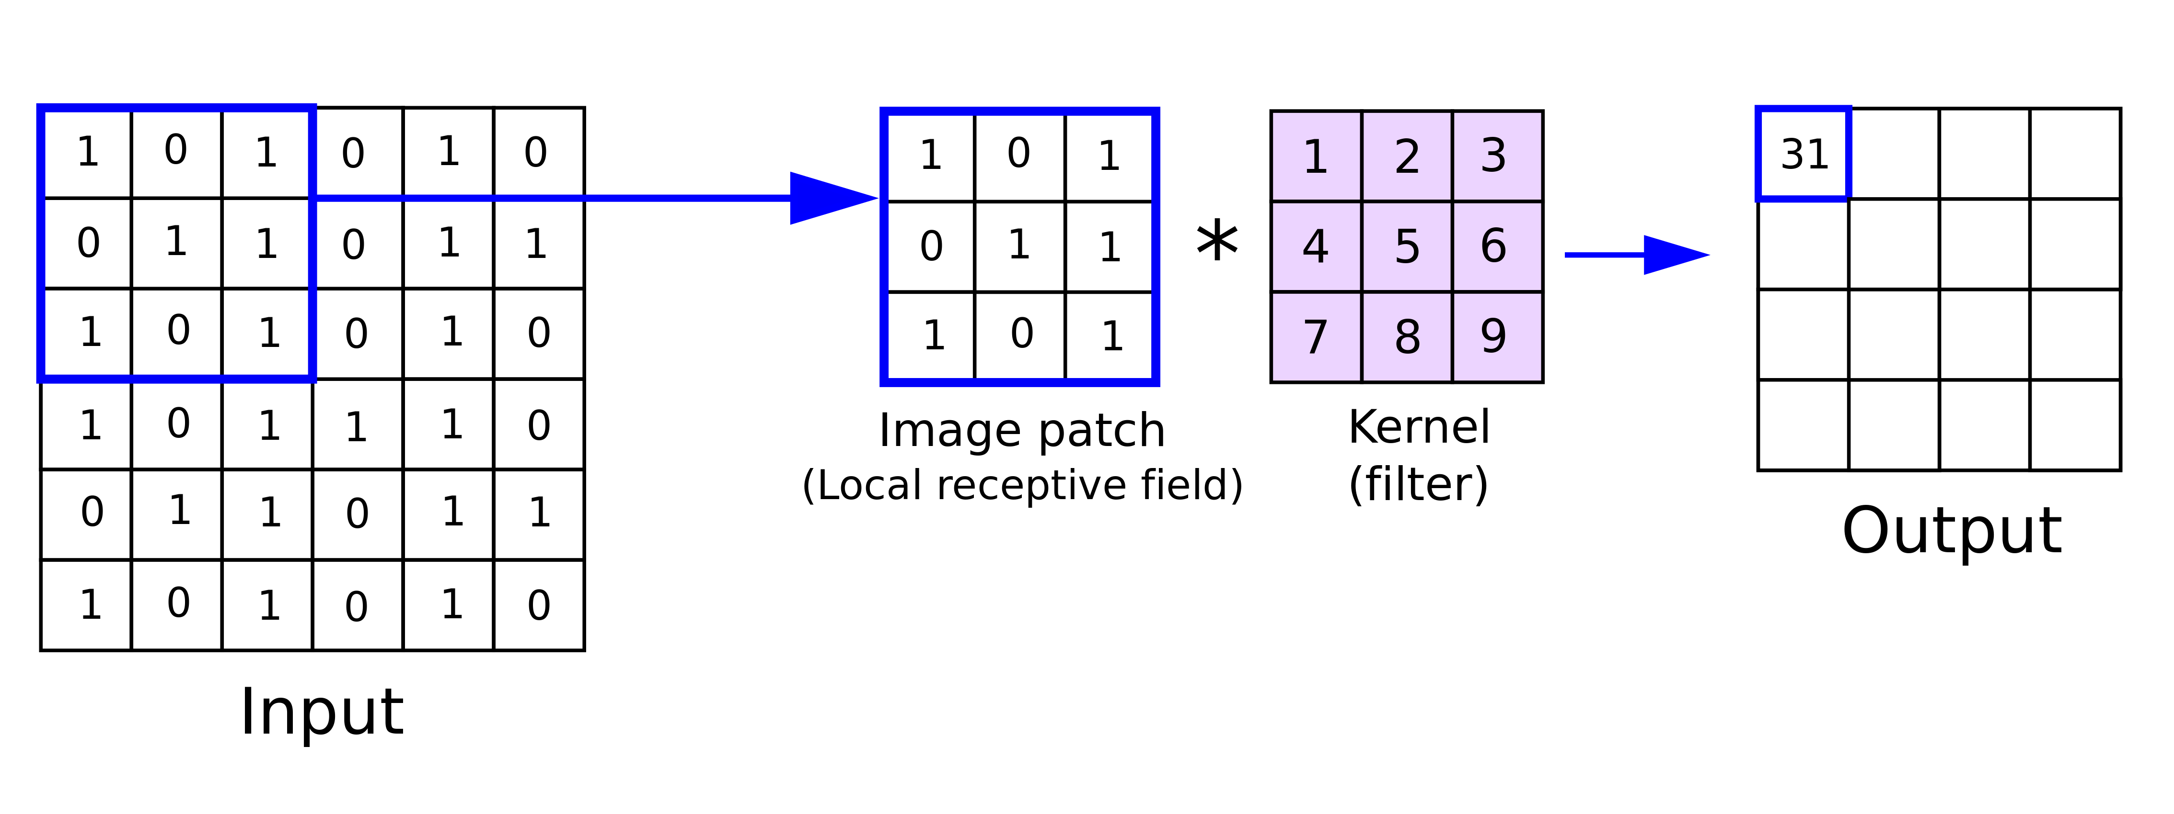
Convolutional layers
Performs “convolutions” (cross-correlations) on data
Recognises “features” in data

Slide 15
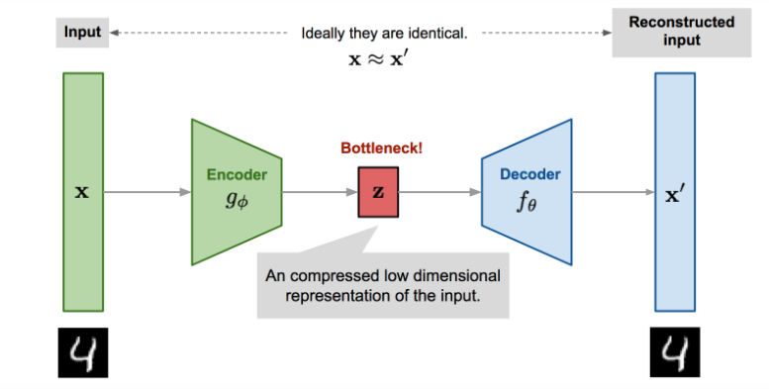
Autoencoder
Quantify the reconstruction error in terms of a loss function
Model cannot learn the identity function
What if we gave it the number 5?
So let’s train an autoencoder on EMRI signals.

Slide 16
Training the autoencoder

Slide 17
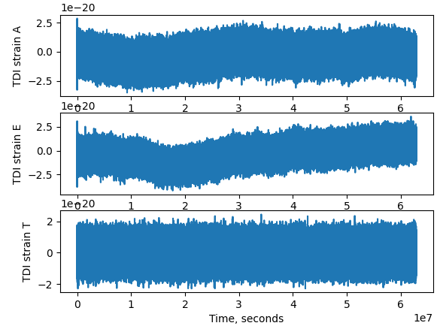
EMRI training dataset
Parameter | Quantity
Dataset size | 1200
Time of signal | 2 years
Sampling rate | 1/15 Hz
Signal length | 4194304
Number of channels | 2 (A,E)
EMRI waveform parameters uniformly sampled over astrophysically valid ranges
Data = EMRI + Gaussian noise background
Data is noise whitened

Slide 18
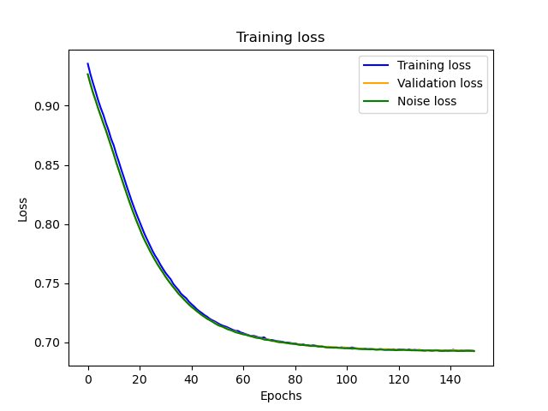

Training the autoencoder
The loss function: mean squared error
Observations:
Training converges to loss 0.7
Noise is equally well reproduced as EMRIs
Why?

Slide 19
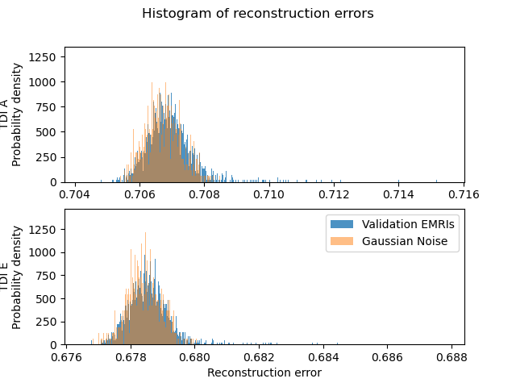
Evaluating the trained autoencoder
Reconstruction error = loss function
Histograms of EMRI and noise losses completely overlap
Ideally:
Find the 95/98/99th percentile of EMRI losses
This becomes our threshold loss when making predictions

Slide 20
Could this be an SNR issue?
Random EMRI parameters lead to random SNRs
But LISA is only sensitive to EMRIs at SNRs >30
Generated EMRIs may be too low in SNR to be picked up by the model
So:
The model instead learns the noise background

Slide 21
Next steps
Find sets of EMRIs parameters that fulfil the desired range of SNRs
Use ML-based methods to “interpolate the SNR function”
Retry the training with reasonable EMRI parameters

